Slide 1
CMP5329 Cyber Security
Week 2-P1: Modern Asymmetric Ciphers (Cont.)
PhD. Ngoc-Tu Nguyen
tunn@uit.edu.vn

Slide 2
Outline
Why asymmetric cryptography?
Factoring Based Cryptography
Logarithm Based Cryptography
Diffie-Hellman key exchange;
Elliptic Curve Cryptography
Some advanced cryptography system (quantum resistance) Standards 202, 203, 204, 205
Notes:
Cipher=a secret system of writing;

Slide 3
A E S-The Four Simple Operations
substitute-bytes (sub)
Non-linear operation based on a defined substitution box
Used to resist cryptanalysis and other mathematical attacks
shift-rows (shr)
Linear operation for producing diffusion
mix-columns (mic)
Elementary operation also for producing diffusion
add-round-key (ark)
Simple set of ⊕ operations on state matrices
Linear operation
Produces confusion

Slide 4
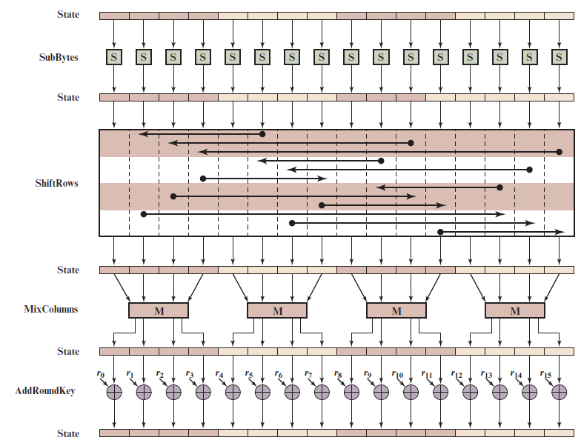
A E S Encryption Round
16 bytes
Notes:
Figure 6.4 depicts the structure of a full encryption round.

Slide 5
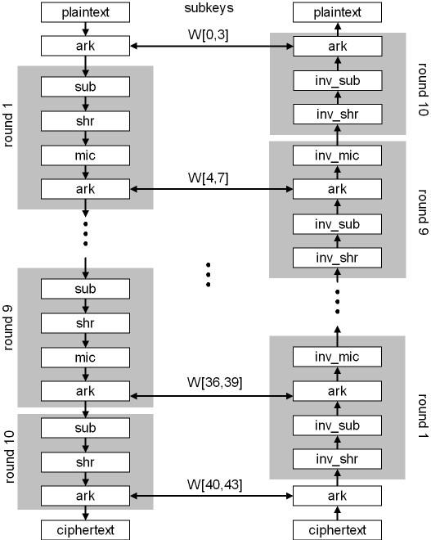
AES-128
AES-128: 10 rounds
AES-192: 12 rounds
AES-256:14 round

Slide 6
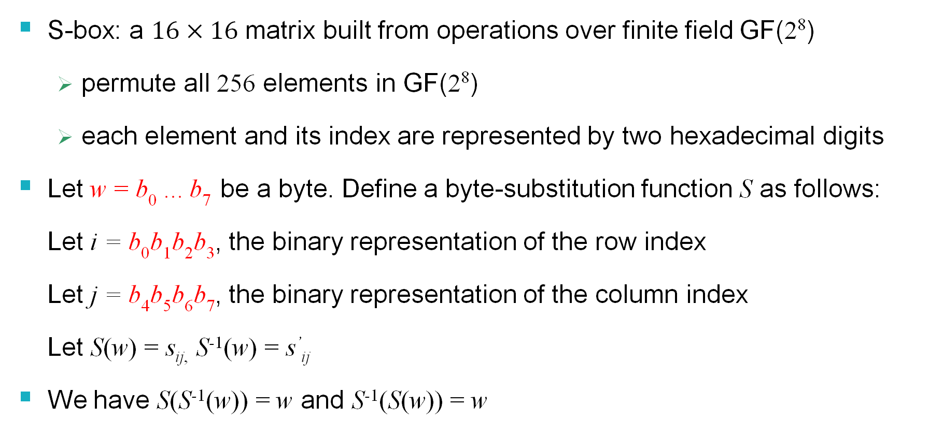
AES Substution Box (S-Box)
S-box: a $16×16$ matrix built from operations over finite field GF(2⁸)
permute all 256 elements in GF(2⁸)
each element and its index are represented by two hexadecimal digits
Let w = b₀ ... b₇ be a byte. Define a byte-substitution function S as follows:
Let i = b₀b₁b₂b₃, the binary representation of the row index
Let j = b₄b₅b₆b₇, the binary representation of the column index
Let S(w) = s_{ij,} S⁻¹(w) = s’_{ij}
We have S(S⁻¹(w)) = w and S⁻¹(S(w)) = w

Slide 7
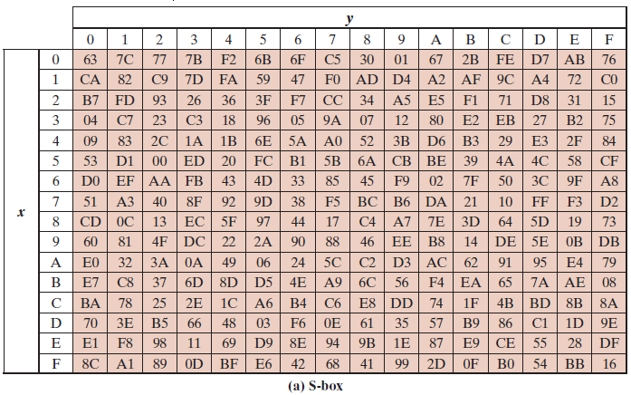
AES S-Boxes (1 of 2)
P=1101 0011
13
i =D
j= 3
C=66 = (01100110)₂

Slide 8
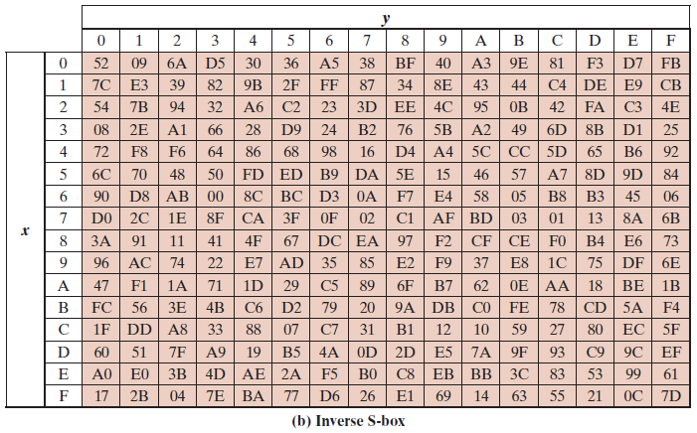
AES inverse substution Box (2 of 2)
C=66 = (0110 0110)₂
i =6
j=6
P=D3 = (1101 0011)₂
Notes:
The inverse substitute byte transformation , called InvSubBytes, makes use
of the inverse S-box shown in Table 6.2b.

Slide 9
Substitute-Bytes (sub)
Substitution function that takes a byte as an input, uses its first four bits as the row index and the last four bits as the column index, and outputs a byte using a table-lookup at the S-box
Let A be a state matrix. Then
S(a_{0,0} ) S(a_{0,1} ) S(a_{0,2} ) S(a_{0,3} )
C=sub(A) = S (a_{1,0} ) S(a_{1,1} ) S(a_{1,2} ) S(a_{1,3} ) S(a_{2,0} ) S(a_{2,1} ) S(a_{2,2} ) S(a_{2,3} )
S(a_{3,0} ) S(a_{3,1} ) S(a_{3,2} ) S(a_{3,3} )
sub⁻¹(A) will just be the inverse substitution operation applied to the matrix
S⁻¹ (c_{0,0} ) S⁻¹ (c_{0,1} ) S⁻¹ (c_{0,2} ) S⁻¹ (c_{0,3} )
sub⁻¹ (C) = S⁻¹ (c_{1,0} ) S⁻¹ (c_{1,1} ) S⁻¹ (c_{1,2} ) S⁻¹ (c_{1,3} )
S⁻¹ (c_{2,0} ) S⁻¹ (c_{2,1} ) S⁻¹ (c_{2,2} ) S⁻¹ (c_{2,3} )
S⁻¹ (c_{3,0} ) S⁻¹ (c_{3,1} ) S⁻¹ (c_{3,2} ) S⁻¹ (c_{3,3} )
We have sub(sub⁻¹(A)) = sub⁻¹(sub(A)) = A
_{S-Box}
a_{0,0} a_{0,1} a_{0,2} a_{0,3}
a_{1,0} a_{1,1} a_{1,2} a_{1,3}
a_{2,0} a_{2,1} a_{2,2} a_{2,3} a_{3,0} a_{3,1} a_{3,2} a_{3,3}
_{Inverse S-Box}

Slide 10
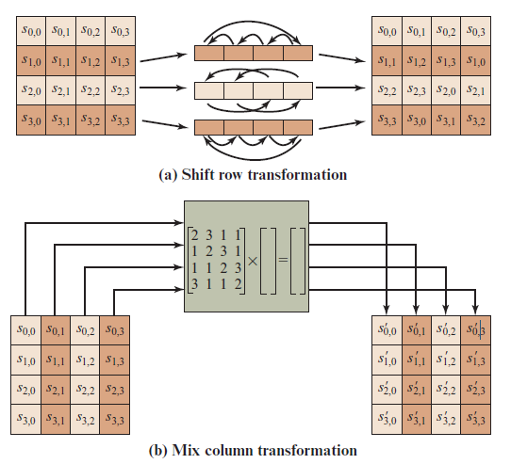
A E S Row and Column Operations
Notes:
The forward shift row transformation ,
called ShiftRows, is depicted in Figure 6.7a. The first row of State is not altered. For
the second row, a 1-byte circular left shift is performed. For the third row, a 2-byte
circular left shift is performed. For the fourth row, a 3-byte circular left shift is performed.
The following is an example of ShiftRows.
The inverse shift row transformation , called InvShiftRows, performs the circular
shifts in the opposite direction for each of the last three rows, with a 1-byte
circular right shift for the second row, and so on.
The forward mix column transformation,
called MixColumns, operates on each column individually. Each byte of a column
is mapped into a new value that is a function of all four bytes in that column. The
transformation can be defined by the following matrix multiplication on State
(Figure 6.7b)
Each element in the product matrix is the sum of products of elements of one row
and one column. In this case, the individual additions and multiplications are
performed in GF(2⁸ ).

Slide 11
Shift-Rows (shr)
shr(A) performs a left-circular-shift i – 1 times on the i-th row in the matrix A
a_{0,0} a_{0,1} a_{0,2} a_{0,3}
shr(A) = a_{1,1} a_{1,2} a_{1,3} a_{1,0 = C}
a_{2,2} a_{2,3} a_{2,0} a_{2,1}
a_{3,3} a_{3,0} a_{3,1} a_{3,2}
shr⁻¹(A) performs a right-circular-shift i – 1 times on the i-th row in the matrix A
a_{0,0} a_{0,1} a_{0,2} a_{0,3}
shr⁻¹(C)= a_{1,0} a_{1,1} a_{1,2} a_{1,3}
a_{2,0} a_{2,1} a_{2,2} a_{2,3}
a_{3,0} a_{3,1} a_{3,2} a_{3,3}
We have shr(shr⁻¹(A)) = shr⁻¹(shr(A)) = A
0
a_{0,0} a_{0,1} a_{0,2} a_{0,3}
a_{1,0} a_{1,1} a_{1,2} a_{1,3}
a_{2,0} a_{2,1} a_{2,2} a_{2,3} a_{3,0} a_{3,1} a_{3,2} a_{3,3}
1
2
3

Slide 12
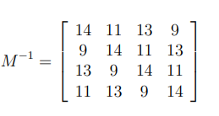
Mix-Columns (mic)
M
A
a_{0,0} a_{0,1} a_{0,2} a_{0,3}
a_{1,0} a_{1,1} a_{1,2} a_{1,3}
a_{2,0} a_{2,1} a_{2,2} a_{2,3} a_{3,0} a_{3,1} a_{3,2} a_{3,3}
Encrypt
2 3 1 1
1 2 3 1
1 1 2 3 3 1 1 2
a_{0,0} a_{0,1} a_{0,2} a_{0,3}
a_{1,0} a_{1,1} a_{1,2} a_{1,3}
a_{2,0} a_{2,1} a_{2,2} a_{2,3} a_{3,0} a_{3,1} a_{3,2} a_{3,3}
A=
=C
$M^{−1}$
C
Decrypt
c_{0,0} c_{0,1} c_{0,2} c_{0,3}
c_{1,0} c_{1,1} c_{1,2} c_{1,3}
c_{2,0} c_{2,1} c_{2,2} c_{2,3} c_{3,0} c_{3,1} c_{3,2} c_{3,3}
A
Addition, subtraction, multiplication, and division on bytes?

Slide 13
Finite Field Arithmetic (3/3)
In the Advanced Encryption Standard (A E S) all operations are performed on 8-bit (1 byte);
The arithmetic operations of addition, multiplication, and division are performed over the finite field G F(2⁸)
addition,
subtraction,
multiplication,
division on polynomials
mod (x⁸ + x⁴ + x³ + x + 1)
Rijndael's finite field
$r= b_{7}b_{6}b_{5}b_{4}b_{3}b_{2}b_{1}b_{0}$ (1 byte)
$$r\left(x\right)={b_{7}x^{7}+b_{6}x^{6}+b_{5}x^{5}+b_{4}x^{4}+b_{3}x^{3}{+b}_{2}x^{2}{+b_{1}x}^{1}+b}_{0}$$
GF(2)[x]/(x⁸ + x⁴ + x³ + x + 1)
https://en.wikipedia.org/wiki/Finite_field_arithmetic

Slide 14
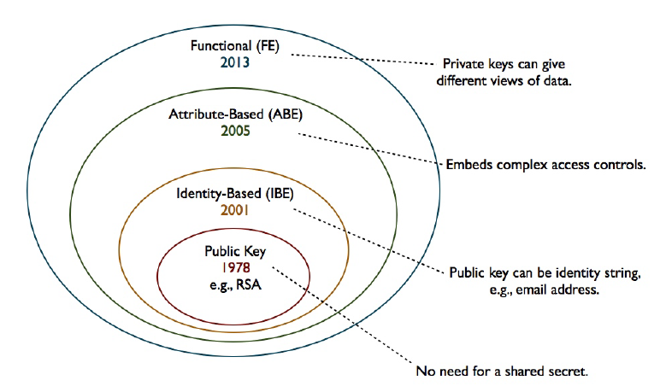





Moden Asymmetric ciphers
Symmetric cipher vs Asymmetric cipher
Hommophic, Searchable encryption,..
$ID_{A}(atributes)$
$ID_{B}(atributes)$
$$(PK_{A}, \{SK_{A},SK_{B},..\})$$
ID
$$(PK_{A}, SK_{A})$$
$$(PK_{A}, SK_{A})$$

Slide 15
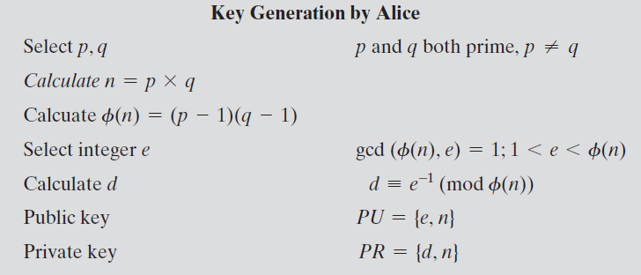
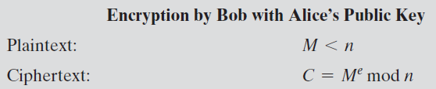
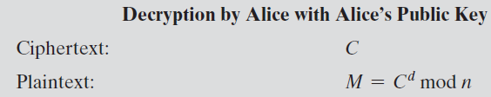


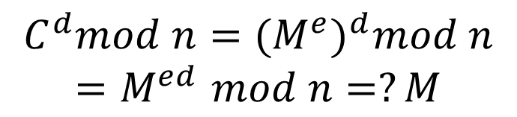
Implementation the R S A Algorithm (review)
Fermat's little theorem
λ(n) = lcm(p − 1, q − 1)
$$e.d=1 mod φ(n)$$
Carmichael's theorem
$$e.d=1 mod λ(n)$$
$$C^{d}mod n={{(M}^{e})}^{d}mod n$$
$${=M}^{ed}mod n=?M$$
Notes:
Figure 9.5 summarizes the RSA algorithm. It corresponds to Figure 9.1a: Alice
generates a public/private key pair; Bob encrypts using Alice’s public key; and Alice
decrypts using her private key.

Slide 16


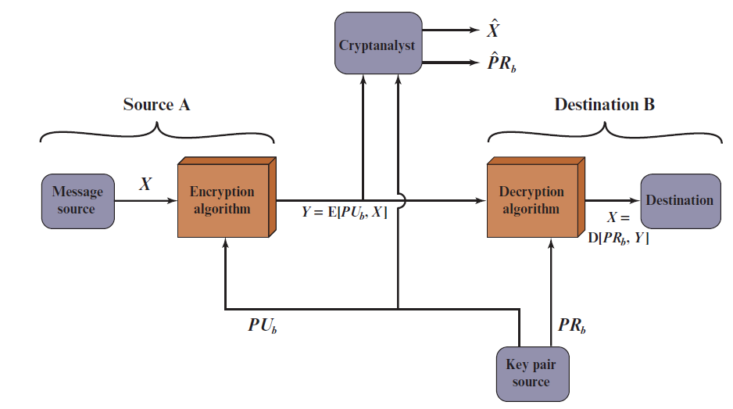
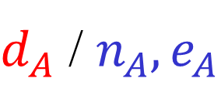


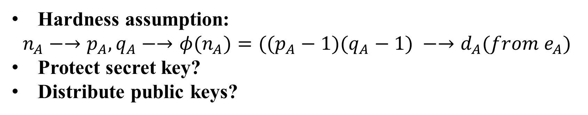

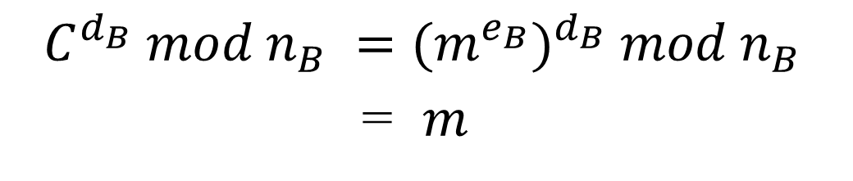

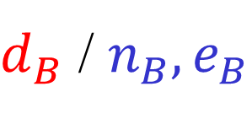

RSA: Confidentiality
$$n_{A}=p_{A}.q_{A}$$
$$n_{B}=p_{B}.q_{B}$$
A
B
$d_{A}$ / $n_{A}, e_{A}$
$d_{B}$ / $n_{B}, e_{B}$
$$e_{A}.d_{A}=1 mod φ(n_{A})$$
$$e_{B}.d_{B}=1 mod φ(n_{B})$$
$$C =m^{e_{B}} mod n_{B}$$
$$C^{d_{B}} mod n_{B} ={(m^{e_{B}})}^{d_{B}} mod n_{B}$$
= $m$
Hardness assumption:
$$n_{A}−→p_{A},q_{A}−→φ(n_{A})=((p_{A}−1)(q_{A}−1) −→d_{A}(from e_{A})$$
Protect secret key?
Distribute public keys?
Notes:
Let us take a closer look at the essential elements of a public-key encryption
scheme, using Figure 9.2 (compare with Figure 3.2).
The scheme illustrated in Figure 9.2 provides confidentiality.

Slide 17
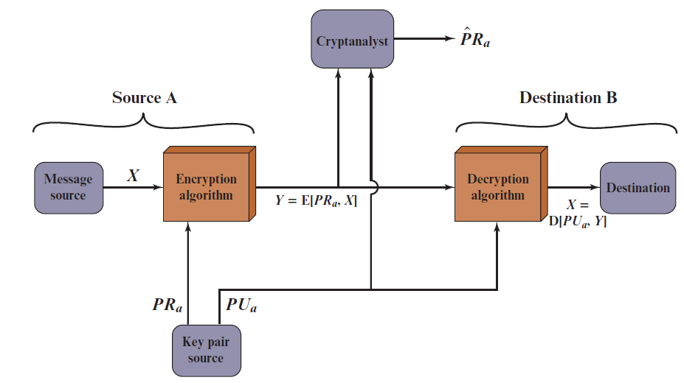

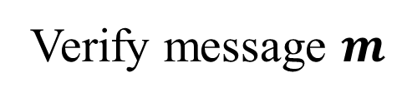
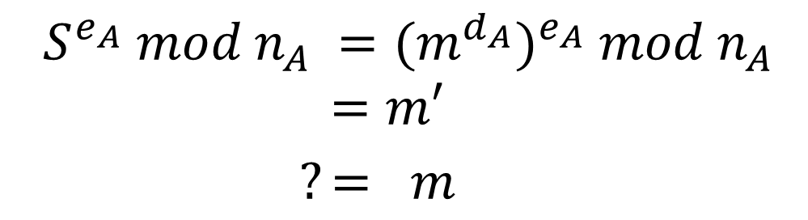

RSA: Authentication
A
B
$d_{A}$ / $n_{A}, e_{A}$
$d_{B}$ / $n_{B}, e_{B}$
$$S =m^{d_{A}} mod n_{A}$$
$$(m,S )$$
Verify message $m$
$$S^{e_{A}} mod n_{A} ={(m^{d_{A}})}^{e_{A}} mod n_{A}$$
$$=m′$$
$?= m$
Protect secret key?
Distribute public keys?
Sent by A
Original (integrity)
Notes:
Let us take a closer look at the essential elements of a public-key encryption
scheme, using Figure 9.2 (compare with Figure 3.2).
The scheme illustrated in Figure 9.2 provides confidentiality.

Slide 18
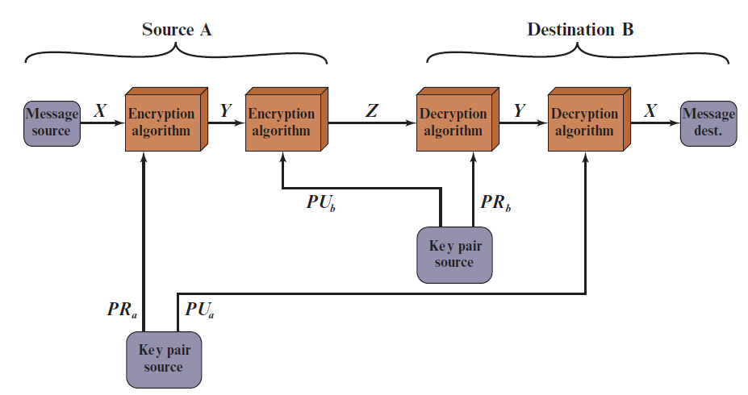


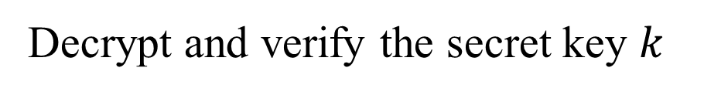
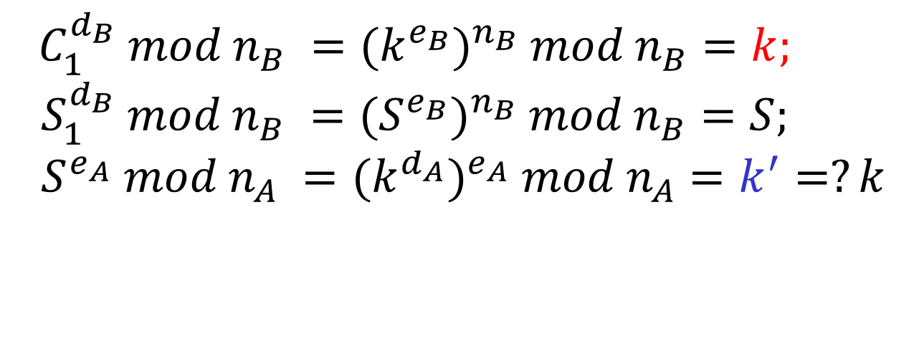
RSA: Authentication and Secrecy
A
B
$d_{A}$ / $n_{A}, e_{A}$
$d_{B}$ / $n_{B}, e_{B}$
$$S =k^{d_{A}} mod n_{A}$$
$$(C_{1}=k^{e_{B}},{S_{1}=S}^{e_{B}} )$$
Decrypt and verify the secret key $k$
$$C_{1}^{d_{B}} mod n_{B} ={(k^{e_{B}})}^{n_{B}} mod n_{B}=k;$$
$$S_{1}^{d_{B}} mod n_{B} ={(S^{e_{B}})}^{n_{B}} mod n_{B}=S;$$
$$S^{e_{A}} mod n_{A} ={(k^{d_{A}})}^{e_{A}} mod n_{A}=k^{′}=?k$$
Limitation?
Notes:
Let us take a closer look at the essential elements of a public-key encryption
scheme, using Figure 9.2 (compare with Figure 3.2).
The scheme illustrated in Figure 9.2 provides confidentiality.

Slide 19
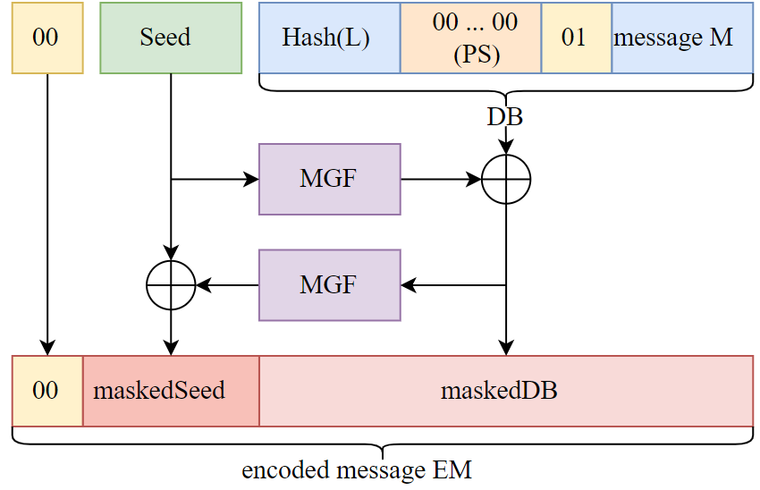


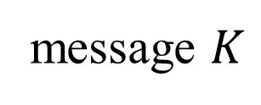
Encryption Using Optimal Asymmetric Encryption Padding (O A E P)
MGF: a hash function
$$K$$
message $K$
$$DB=H(L)||0000.. ||01||K$$
Y = MGF(Seed) ⊕ DB
X= MGF(Y) ⊕ Seed
?
X
Y

Slide 20
Outline
Why asymmetric cryptography?
Factoring Based Cryptography (P1,2)
Logarithm Based Cryptography (P3)
Diffie-Hellman key exchange;
Elliptic Curve Cryptography (P4)
Some advanced cryptography system (quantum resistance)
Notes:
Cipher=a secret system of writing;

Slide 21

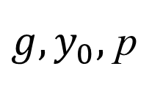

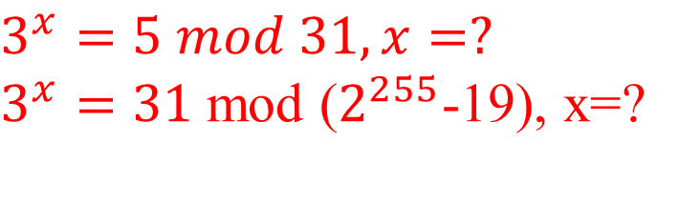

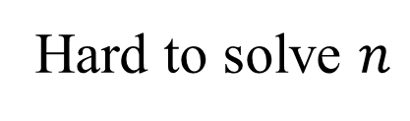
Discrete Logarithm problem
$$Finitemultiplicative group \left(G, .\right)=<g> =\{g^{n}:n∈ ℤ\}$$
AutoSeededRandomPool prng;
Integer p, q, g;
CryptoPP::PrimeAndGenerator pg;
pg.Generate(1, prng, 512, 511);
p = pg.Prime();
q = pg.SubPrime();
g = pg.Generator();
Example: $G=ℤ_{p}\backslash \{0\}= \left\{1,2,…,p−1\right\}=<g>$
Easy to compute
$$y_{0}=g^{n} mod p$$
$$g, n$$
Hard to solve $n$
${g, y}_{0},$ p
$$g^{n}=y_{0} mod p$$
$$3^{x}=5 mod 31, x=?$$
$3^{x}=31$mod ($2^{255}$-19), x=?
Hard to solve equation $g^{x}=a mod p in finite field!$

Slide 22
Outline
Why asymmetric cryptography?
Factoring Based Cryptography (P1)
RSA signature;
Logarithm Based Cryptography (P2)
ElGamal cipher
Diffie-Hellman key exchange;
Elliptic Curve Cryptography (P3)
Some advanced cryptography system (quantum resistance)
Notes:
Cipher=a secret system of writing;

Slide 23
Outline
Why asymmetric cryptography?
Factoring Based Cryptography (P1)
RSA signature;
Logarithm Based Cryptography (P2)
Diffie-Hellman key exchange;
Elliptic Curve Cryptography (P3)
Some advanced cryptography system (quantum resistance)
Notes:
Cipher=a secret system of writing;

Slide 24

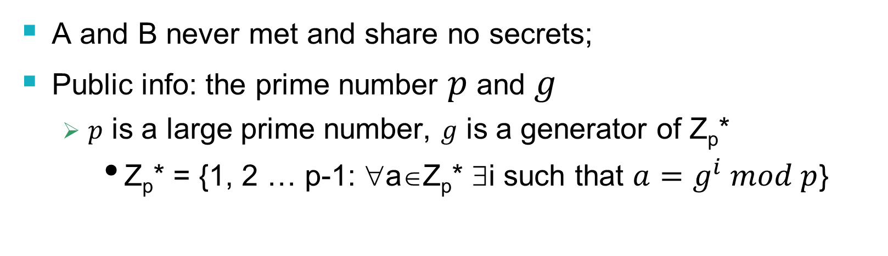

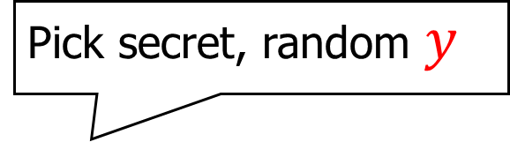
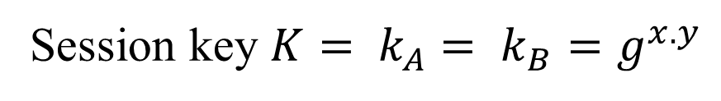
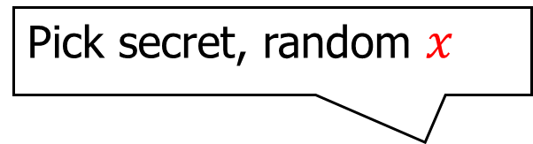
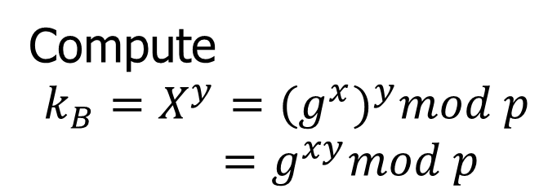
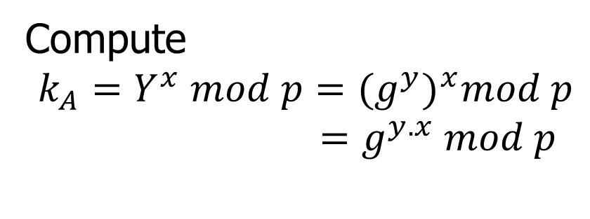
Diffie-Hellman key exchange
A and B never met and share no secrets;
Public info: the prime number $p$ and $g$
$p$ is a large prime number, $g$ is a generator of Z_{p}*
Z_{p}* = {1, 2 … p-1: ∀a∈Z_{p}* ∃i such that $a=g^{i} mod p$}
Pick secret, random $x$
Pick secret, random $y$
$$X=g^{x} mod p$$
A
$$Y=g^{y} mod p$$
B
Compute
$k_{A}=Y^{x} mod p={{(g}^{y})}^{x}mod p$
$=g^{y.x} mod p$
Compute
$k_{B}=X^{y}={(g^{x})}^{y}mod p$
$=g^{xy}mod p$
Session key $K= k_{A}$ $= k_{B}=g^{x.y}$
Symmetric key

Slide 25
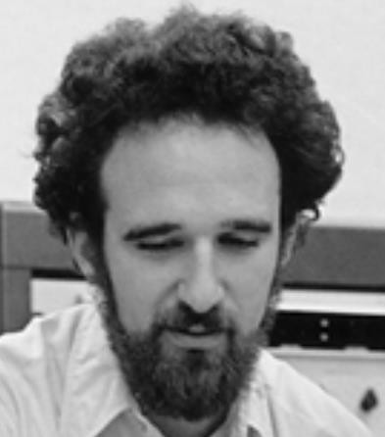
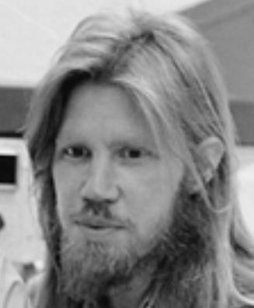


Diffie-Hellman exchange Protocol (DHE)
p = 1606938044258990275541962092341162602522202993782792835301301
𝑔 = 123456789
𝑔^{𝑎} mod p = 78467374529422653579754596319852702575499692980085777948593
𝑔^{𝑏} mod p =
560048104293218128667441021342483133802626271394299410128798
𝑎 =
685408003627063
761059275919665
781694368639459
527871881531452
𝑏 =
362059131912941
987637880257325
269696682836735
524942246807440
𝑔^{𝑎𝑏} mod p = 437452857085801785219961443000845969831329749878767465041215
${{(g}^{b})}^{a}$ $mod p$
$${{(g}^{a})}^{b}mod p$$

Slide 26
Why Is Diffie-Hellman Secure?
Discrete Logarithm (DL) problem:
given g^{x} mod p, it’s hard to extract x
There is no known efficient algorithm for doing this
This is not enough for Diffie-Hellman to be secure!
Computational Diffie-Hellman (CDH) problem:
given g^{x} and g^{y}, it’s hard to compute g^{xy} mod p
… unless you know x or y, in which case it’s easy
Decisional Diffie-Hellman (DDH) problem:
given g^{x} and g^{y}, it’s hard to tell the difference between g^{xy} mod p and g^{r} mod p where r is random

Slide 27
Properties of Diffie-Hellman
Assuming DDH problem is hard, Diffie-Hellman protocol is a secure key establishment protocol against passive attackers
Eavesdropper can’t tell the difference between the established key and a random value
Can use the new key for symmetric cryptography
Basic Diffie-Hellman protocol does not provide authentication
IPsec combines Diffie-Hellman with signatures, anti-DoS cookies, etc.

Slide 28











Man-in-the middle attacks the DHE
$$g^{a} mod p$$
$$(a,g^{a})$$
$$(b,g^{b})$$
$$g^{b} mod p$$
$$sk={{(g}^{b})}^{a}={{(g}^{a})}^{b}=g^{ab}mod p$$
B()
A(Putin)
man-in-the-middle attack!
$$g^{m} mod p$$
$$g^{a} mod p$$
$$g^{m} mod p$$
$$g^{b} mod p$$
$$sk_{1}=g^{am}mod p$$
$$sk_{2}=g^{bm}mod p$$

Slide 29
Group (G,+)
Ring (R, +, ×)
Elliptic Curve Cryptography- Motivations
can do + −
lightweight computational overhead?
can do + − ×
can do + − × ÷
Field
(F, +, ×)

Slide 30
Elliptic curve
An el iptic curve is a group defined over a field K
elliptic curve group (𝐸,⊕) underlying field (𝐾, +, ×)
can do ⊕ ⊖
can do + − × ÷
operations in underlying field are used and combined to compute the el iptic curve operation ⊕

Slide 31

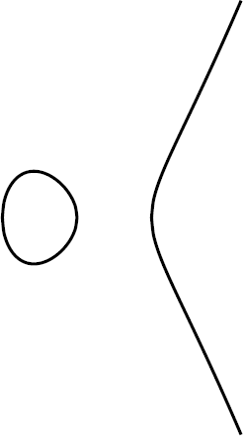
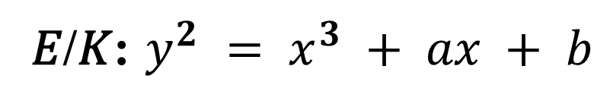
Elliptic curves
Weierstrass form
𝐸 specified by 𝐾, 𝑎, 𝑏
𝐸/𝐾: $y^{2} = x^{3} + ax + b$
𝐸/ℝ : 𝑦² = 𝑥³ + 𝑥 + 1
𝐸/ℝ : 𝑦² = 𝑥³ − 𝑥

Slide 32
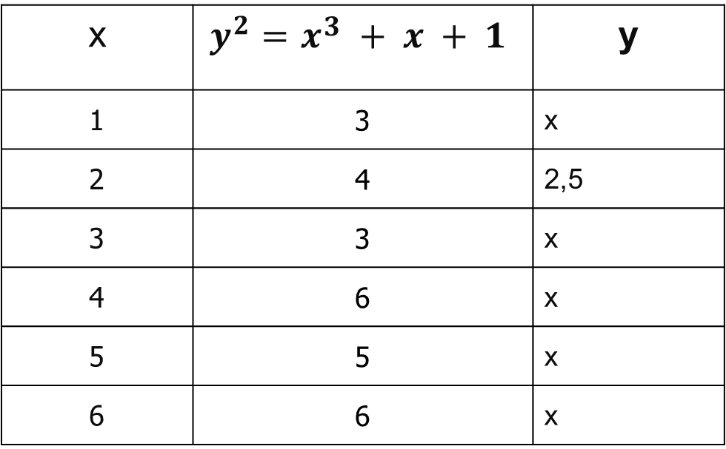
Elliptic curves
Weierstrass form
𝐸/ℝ : 𝑦² = 𝑥³ + 𝑥 + 1
$$E /ℤ_{7} : y2 = x3 + x + 1(mod 7)$$
x | $$y^{2}=x3 + x + 1$$ | y
1 | 3 | x
2 | 4 | 2,5
3 | 3 | x
4 | 6 | x
5 | 5 | x
6 | 6 | x

Slide 33
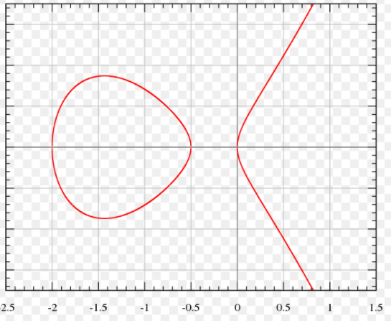
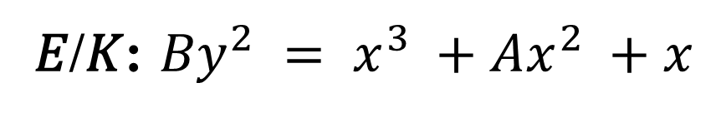
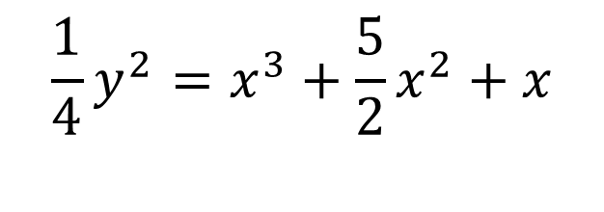
Elliptic curves
Montgomery form
𝐸/𝐾: ${By}^{2} = x^{3} +Ax^{2} +x$
𝐸 specified by 𝐾, A, B
𝐸/ℝ :
$$\frac{1}{4}y^{2}=x^{3}+\frac{5}{2}x^{2}+x$$

Slide 34
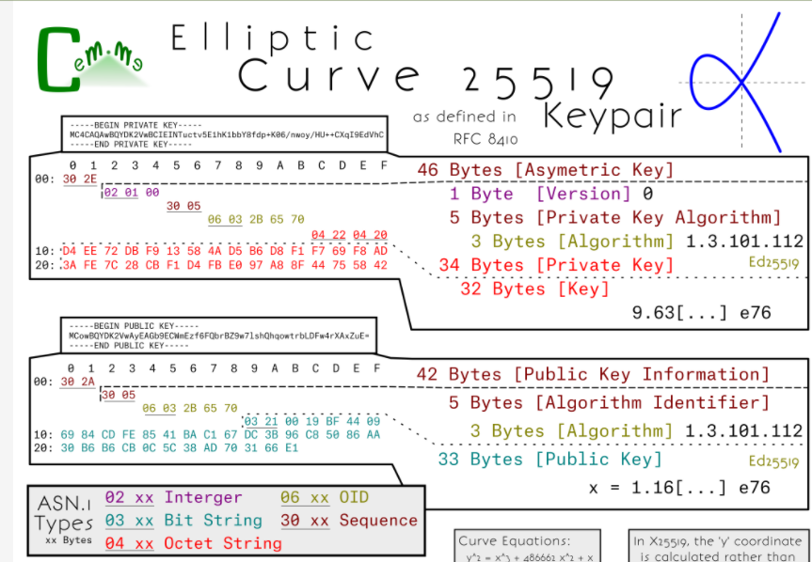
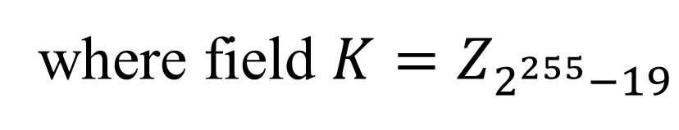
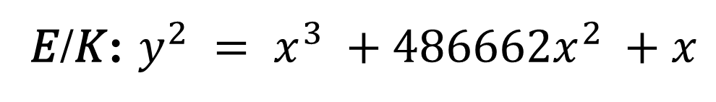
Curve25519
𝐸/𝐾: $y^{2} = x^{3} +486662x^{2} +x$
where field $K=Z_{2^{255}−19}$

Slide 35
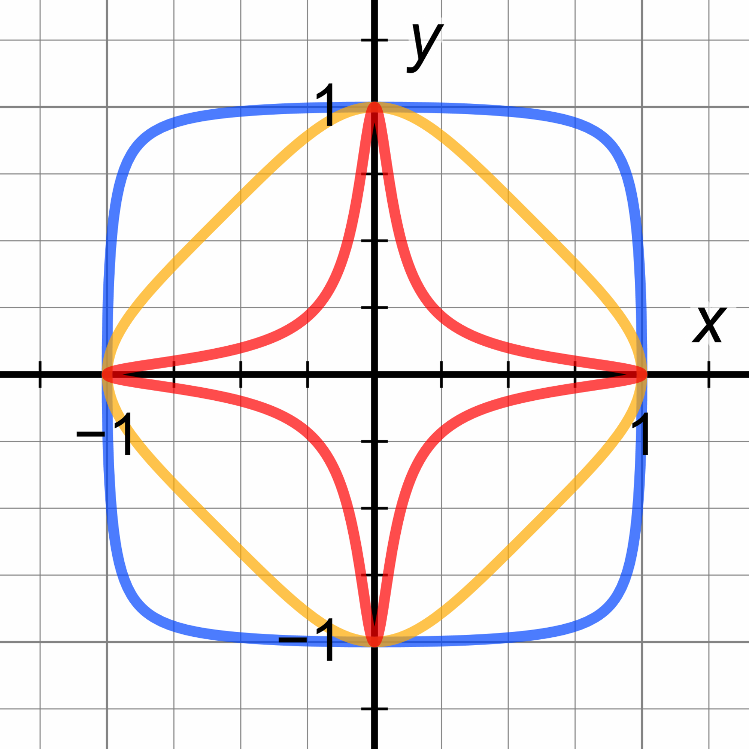

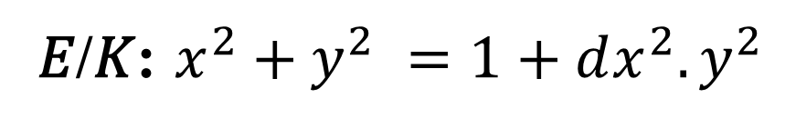
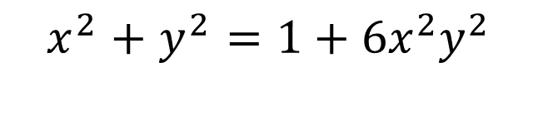
Elliptic curves
Edwards form (Ed)
𝐸/𝐾: $x^{2}+y^{2} =1+dx^{2}.y^{2}$
𝐸 specified by: 𝐾, d
𝐸/ℝ :
$$x^{2}+y^{2}=1+6x^{2}y^{2}$$
https://safecurves.cr.yp.to/

Slide 36
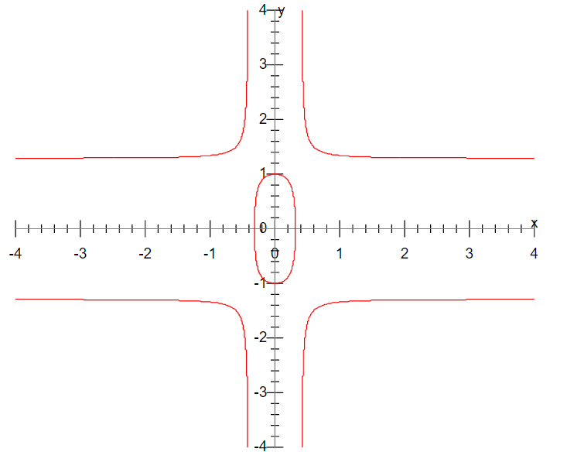
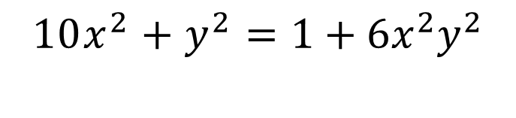

Elliptic curves
Twisted Edwards form
𝐸/𝐾: ${ax}^{2}+y^{2} =1+dx^{2}.y^{2}$
𝐸 specified by: 𝐾, a, d
𝐸/ℝ :
$$10x^{2}+y^{2}=1+6x^{2}y^{2}$$
https://safecurves.cr.yp.to/

Slide 37


Elliptic group
Addition of two points:
y
If P₁ and P₂ are on E, we can define sum
$P1 + P2 = P2 + P1 ≝P_{3}$
as shown in picture
P₂
P₁
x
P₃

Slide 38


Elliptic group
Point Doubling
Special case
=P+P
P+P= O (infinity)

Slide 39

Elliptic group
P+ O = P
O + P = P
P+(-P)= O (infinity)

Slide 40
Elliptic group
Example

Slide 41
Elliptic group
Given two points P, Q in E/K, there is a third point, denoted by P + Q on E/K, and the following relations hold for all P, Q, R in E/K, where K be a finite field
P + Q = Q + P (commutativity)
(P + Q) + R = P + (Q + R) (associativity)
P + O = O + P = P (existence of an identity element)
there exists ( − P) such that − P + P = P + ( − P) = O (existence of inverses)

Slide 42








Elliptic group
Group points 𝐸/𝐾
Subgroup generated by a point $G$
$$<G>=\{G,2G,….,kG,…\}=\{kG:k∈K \} ⊂ E/K$$
$$G$$
$$G$$
$$n=\left|<G>\right|=|\left\{kG:k∈K \right\}|$$
$$3G$$
•
•
$$5G$$
$$h=\frac{\left|\text{E}\text{/}\text{K}\right|}{\left|<G>\right|} is small!$$
•
$$4G$$
•
$$6G$$
$$2G$$
•

Slide 43








Elliptic group
ECC group parameters:
ECC equation (type, coeffection): $a, b,…$
Modulo: $p or f(x)$
Generator point: $G$
Order of $G$: $n = <G> =\{kG:k∈K \}$
Cofactor:
$$<G> =\{kG:k∈K \} ⊂ E/K$$
$$G$$
$$G$$
$$3G$$
•
•
$$5G$$
$$h=\frac{\left|\text{E}\text{/}\text{K}\right|}{\left|<G>\right|}$$
•
$$4G$$
•
$$6G$$
$$2G$$
http://www.secg.org/sec2-v2.pdf
•

Slide 44





Using Elliptic Curves In Cryptography
Hardness assumption.
$d →Q=dG =G+G+….+G$
Discrete Log Problem (DLP):
$$g, p, y=g^{x}mod p ⟼x$$
Elliptic curve discrete logarithm problem (ECDLP)
$$G, Q(=dG) ↦d$$
where $dG =G+G+….+G$
$d$ times

Slide 45
Elliptic Curve Cryptosystems (ECC)
Algorithm | Encryption/Decryption | Digital Signature | Key Exchange
RSA | Yes | Yes | Yes
Elliptic Curve | Yes | Yes | Yes
Diffie–Hellman | No | No | Yes
DSS | No | Yes | No

Slide 46

What Is ECC?
Elliptic curve cryptography [ECC] is a public-key cryptosystem just like RSA, Rabin, and El Gamal.
Every user has a public key $Q(=dG)$ and a private key $d$.
Public key is used for encryption/signature verification.
Private key is used for decryption/signature generation.
Elliptic curves are used as an extension to other current cryptosystems.
Elliptic Curve Diffie-Hellman Key Exchange
Elliptic Curve Digital Signature Algorithm

Slide 47


Generic Procedures of ECC
Both parties agree to some publicly-known data items
The elliptic curve equation
Type, values of a and b (or others)
Modulo: prime p or f(x)
A base point,$G$, taken from the elliptic group;
Others parameters (assure security)
Each user generates their public/private key pair
Private Key:$d∈ [1, p−1]$
Public Key: $Q = d.G=G+G+…+G$
$d$ times

Slide 48

ECC Cipher
Suppose Alice wants to send to Bob an encrypted message.
Both agree on a ECC curver and a base point $G$ .
Alice and Bob create public/private keys.
Alice
Private Key = a
Public Key = Q_{A} = a .$G$
Bob
Private Key = b
Public Key = Q_{B} = b.$G$

Slide 49






ECC Cipher
Alice
public key
Bob
public key
?
public key
private key
$$(G,PK_{B}=bG,SK=b)$$
Input: $M ∈E/K$
Select a random integer
$k∈[1, p−1]$, compute
Decrypt
Encrypt
$$(R,C)$$
$$C−b R$$
$$=M+kb G−b kG$$
$$=M$$
$$R=kG, C=M+k .PK_{B}$$

Slide 50








ECC Diffie-Hellman (ECDHE)
Public: Elliptic curve and a point $G$=(x,y) on curve
Secret: Alice’s a and Bob’s b
$(a{, Q}_{A})$
$(b{, Q}_{B})$
$$Q_{A}(=a.G)$$
$Q_{B}(=b.G$)
Alice, A
Bob, B
Alice computes $K_{A}=a.Q_{B}=ab.G$
Bob computes $K_{B}=b.Q_{A}=ba.G$
These are the same since $K_{A}=K_{B}=ab G$

Slide 51
Diffie-Hellman key exchange attack
$$g^{a} mod p$$
$$(a,g^{a})$$
$$(b,g^{b})$$
$$g^{b} mod p$$
$$sk={{(g}^{b})}^{a}={{(g}^{a})}^{b}=g^{ab}mod p$$
Bob
Alice
man-in-the-middle attack!
$$g^{m} mod p$$
$$g^{a} mod p$$
$$g^{m} mod p$$
$$g^{b} mod p$$
$$sk_{1}=g^{am}mod p$$
$$sk_{2}=g^{bm}mod p$$

Slide 52














Diffie-Hellman key exchange attack
$$Q_{A}$$
$$(a,Q_{A}=aG)$$
$$Q_{B}$$
$$(b,Q_{B}=bG)$$
$$sk=aQ_{B}=bQ_{A}=abG$$
Bob
Alice
man-in-the-middle attack!
$$mG$$
$$aG$$
$$mG$$
$$bG$$
$$(a,Q_{A}=aG)$$
$$(b,Q_{B}=bG)$$
$$sk_{1}=amG$$
$$(m,Q_{M}=mG)$$
$$sk_{2}=bmG$$

Slide 53
Why use ECC?
How do we analyze Cryptosystems?
How difficult is the underlying problem that it is based upon
RSA – Integer Factorization
DH – Discrete Logarithms
ECC - Elliptic Curve Discrete Logarithm problem
How do we measure difficulty?
We examine the algorithms used to solve these problems

Slide 54
Security of ECC
To protect a 128 bit AES key it would take a:
RSA Key Size: 3072 bits
ECC Key Size: 256 bits
How do we strengthen RSA?
Increase the key length
Impractical?
Symmetric Encryption (Key Size in bits) | RSA and Diffie-Hellman (modulus size in bits) | ECC Key Size in bits
56 | 512 | 112
80 | 1024 | 160
112 | 2048 | 224
128 | 3072 | 256
192 | 7680 | 384
256 | 15360 | 512
3
https://nvlpubs.nist.gov/nistpubs/SpecialPublications/NIST.SP.800-57pt1r5.pdf
4
5

Slide 55
Applications of ECC
Many devices are small and have limited storage and computational power
Where can we apply ECC?
Wireless communication devices
Smart cards
Web servers that need to handle many encryption sessions
Any application where security is needed but lacks the power, storage and computational power that is necessary for our current cryptosystems

Slide 56
Benefits of ECC
Same benefits of the other cryptosystems: confidentiality, integrity, authentication and non-repudiation but…
Shorter key lengths
Encryption, Decryption and Signature Verification speed up
Storage and bandwidth savings

Slide 57
Summary of ECC
“Hard problem” analogous to discrete log
Q=kG, where Q,G belong to a prime curve
given k,G → “easy” to compute Q
given Q,G → “hard” to find k
known as the elliptic curve logarithm problem
k must be large enough
ECC security relies on elliptic curve logarithm problem
compared to factoring, can use much smaller key sizes than with RSA etc
for similar security ECC offers significant
computational advantages

